Slide 1

Advancing Medical AI: A New AI Assistant for Clinicians
This presentation outlines the development of an AI-powered assistant designed to support medical professionals. Our goal is to deliver a safe, factual, and deployable Minimum Viable Product (MVP) within four weeks, integrating advanced AI capabilities with existing Electronic Medical Records (EMR).

Slide 2

Executive Overview
Dual-Track MVP Strategy
Our MVP is structured around two parallel development tracks, designed to maximise impact and accelerate delivery:
Agentic RAG System: A sophisticated Retrieval-Augmented Generation (RAG) system operating over a curated medical knowledge base (RAGDB). This includes Short-Term Memory (STM) and Long-Term Memory (LTM) capabilities for enhanced contextual understanding.
Symptom-to-Diagnosis Assistant: A lightweight student model, distilled from larger, more powerful teacher models like Gemini and MedGemma, focusing on efficient symptom-to-diagnosis inference.
EMR Retrieval POC: We are developing a Proof of Concept (POC) for secure EMR retrieval, ensuring strict privacy and compliance safeguards are in place from the outset.
Initial Fine-Tuning & Augmentation: Comprehensive experiments on model fine-tuning and data augmentation have already been completed, laying the groundwork for robust performance.

Slide 3
Team & Structure
Streamlined Development Teams
Our project is organised into distinct streams, each with primary and support members, ensuring clear ownership and efficient execution for the Medical AI Assistant MVP.
A. Infra & Orchestration
Dylan
Vinh
FastAPI + Docker + RAGDB setup for scalable deployment
B. Prompting & API
Hai
Dylan
Prompt library development, Gemini API adapters
C. Naive RAG
Henry
Vinh
Semantic search, vector database integration (vDB)
D1. Distillation
Liam
Liam
Teacher–student model distillation techniques
D2. Fine-tuning
Liam
Henry
Augmentation strategies, GRPO/LoRA fine-tuning

Slide 4


Project Roadmap
Accelerated 4-Week MVP Timeline
Our aggressive four-week timeline is designed to rapidly prototype and deliver a functional MVP for the Medical AI Assistant, culminating in a deployable FastAPI + Docker service.
Week 4: Prototype Integration & Deployment
Week 3: Stream Findings & Datasets
Week 2: Foundation & Resources
Integrate Phase-1 prototypes into a cohesive system. The deliverable is a one-click FastAPI + Docker service with chat, retrieval, and model endpoints, complete with observability and safety guardrails.
Each stream delivers findings reports, including initial data ingestion, knowledge distillation, and fine-tuning datasets, alongside Docker Compose infrastructure and prompt packs.
Establish core roles and allocate essential resources. This includes finalising team assignments and setting up development environments.
This structured approach ensures continuous progress and a tangible output by the end of the four-week period.

Slide 5

Technical Approach
Dual-Model Strategy: Teachers & Students
Our model strategy leverages a teacher-student paradigm to achieve both high performance and deployment efficiency for the Medical AI Assistant.
Teacher Models: We utilise powerful, large-scale models such as Gemini 2.5 Pro/Flash and MedGemma-27B-it for their advanced reasoning and comprehensive medical knowledge.
Student Models: For local deployment and efficiency, we are fine-tuning smaller, Qwen3-4B/8B models using QLoRA, making them suitable for the assistant’s real-time needs.
Initial trials have demonstrated promising results:
Successful smoke inference tests on Qwen3 models.
Effective distillation techniques employing Chain-of-Thought (CoT) trimming to transfer reasoning capabilities.
Tested GRPO (Generative Reasoning Policy Optimisation) augmentation loops to enhance model robustness and factual accuracy.

Slide 6




Model Refinement
Advanced Fine-Tuning & Augmentation
Knowledge Distillation
Data Augmentation
Transferring knowledge from larger 'teacher' models (e.g., Gemini, MedGemma) to smaller 'student' models (e.g., Qwen3) using question-answer pairs and their underlying rationales. This ensures efficient, high-fidelity knowledge transfer.
Generating diverse training data through paraphrasing medical texts, creating hard negatives to improve discrimination, and forming contrastive triples to enhance model understanding of nuanced relationships.
Reasoning Augmentation (GRPO)
Teacher-Conditioned Synthesis
Implementing Generative Reasoning Policy Optimisation (GRPO) to train models to produce structured, concise rationales, significantly reducing output verbosity while maintaining accuracy.
Utilising teacher models to condition generative processes, creating highly diverse and contextually relevant question-answer pairs for further model training and robustness.
These techniques are crucial for ensuring the Medical AI Assistant provides factual, concise, and clinically relevant responses.

Slide 7
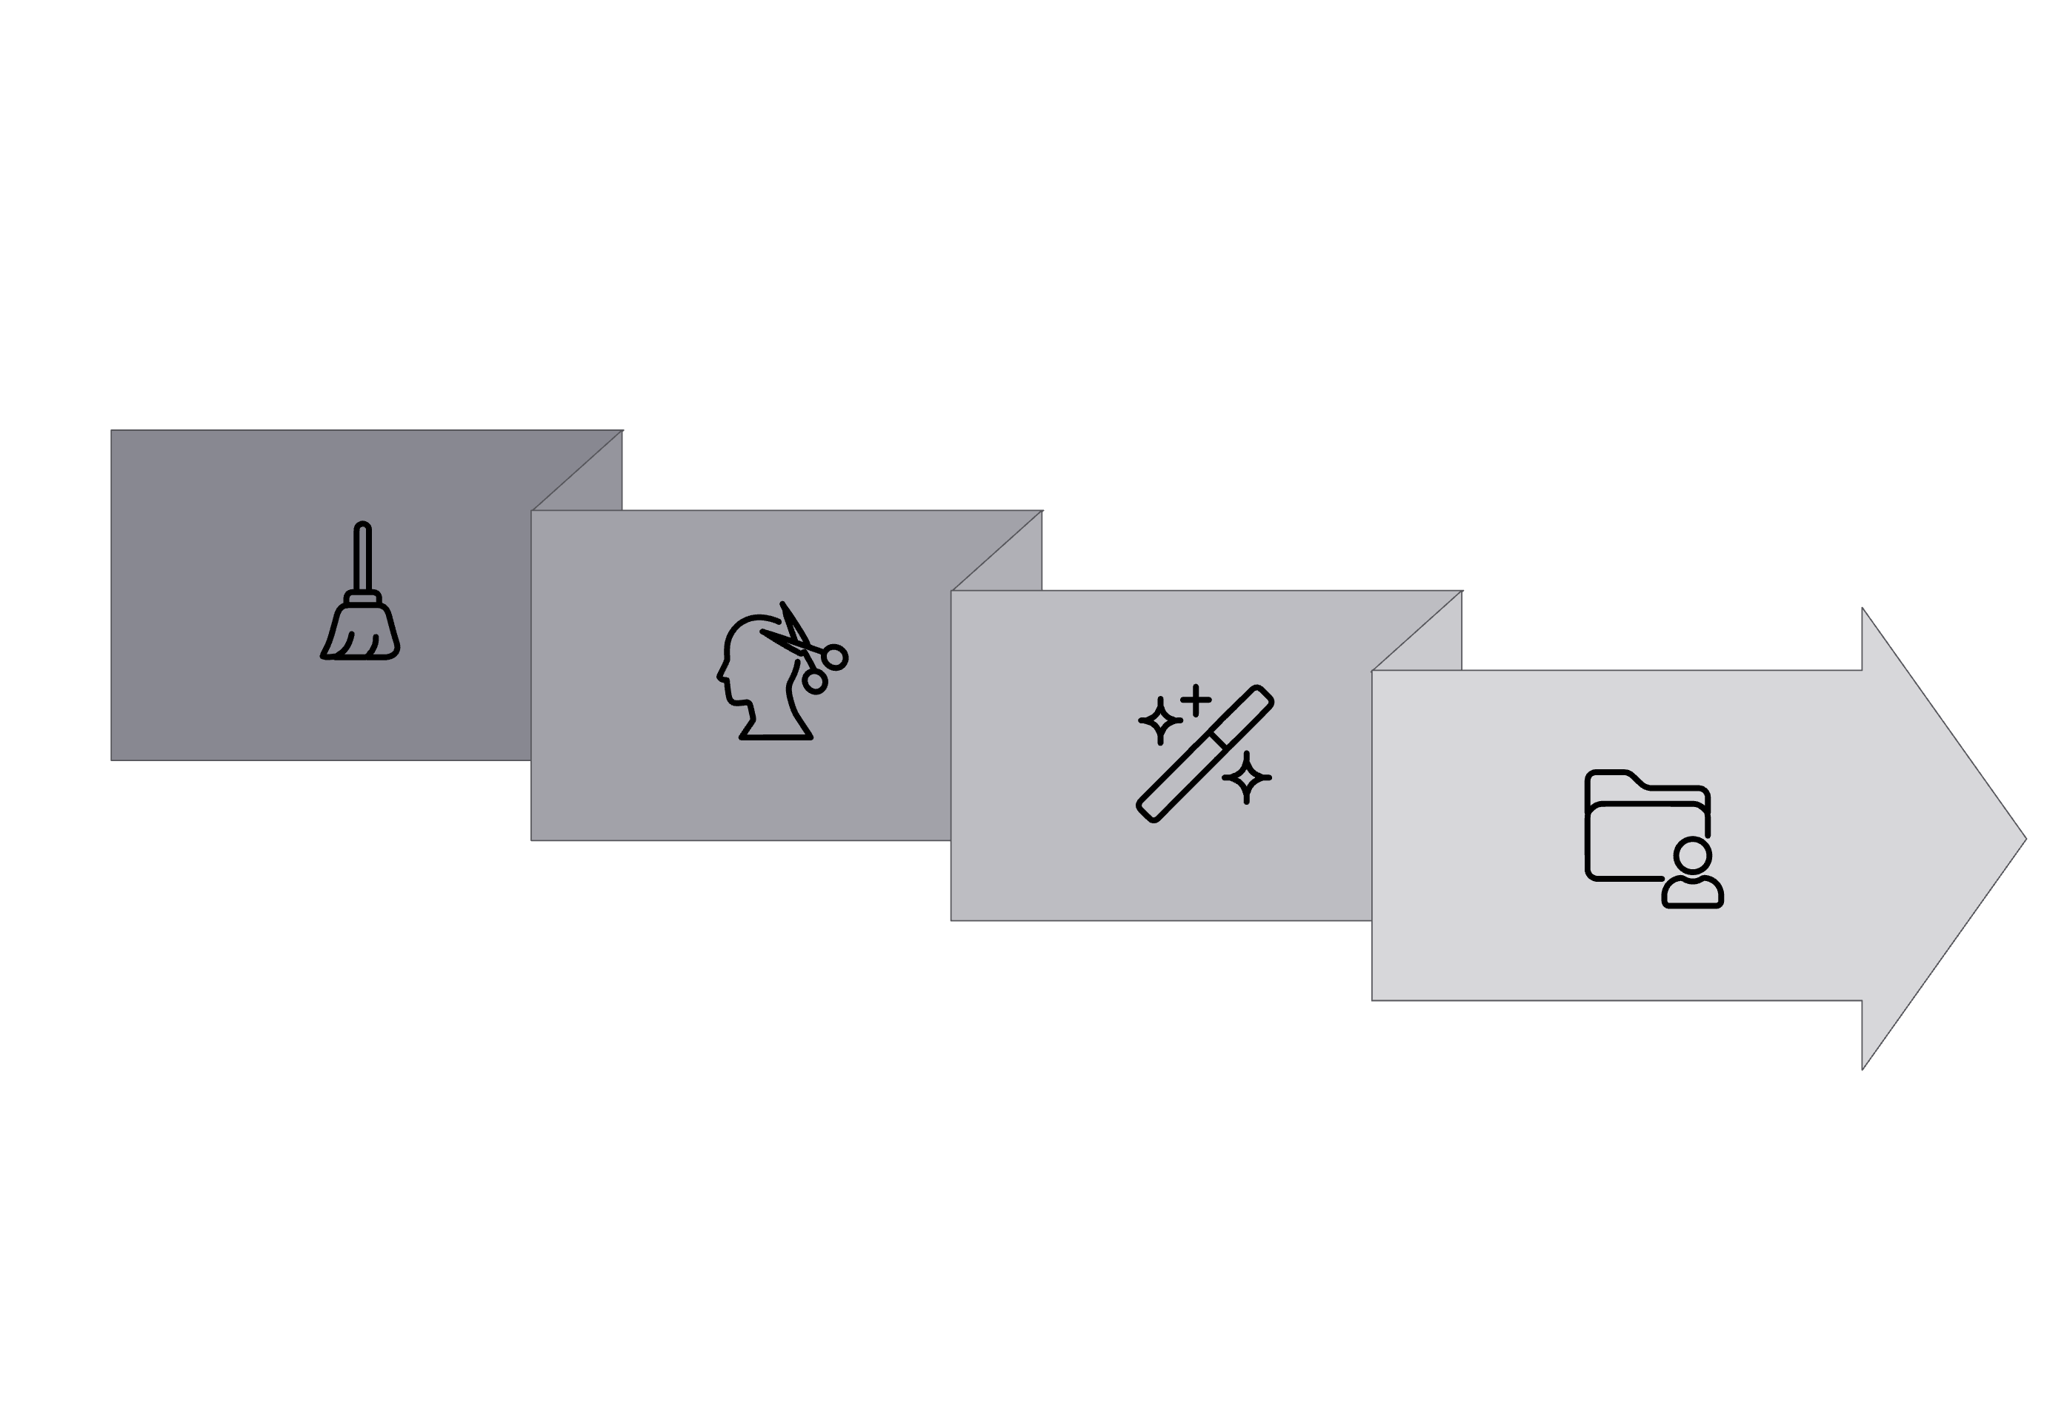




Core Functionality
Robust RAG Architecture
The Retrieval-Augmented Generation (RAG) architecture is the backbone of our Medical AI Assistant, designed for efficient and accurate information retrieval and synthesis.
Chunk
Upsert
Clean
Embed
Data Pipeline: Involves a systematic process of cleaning, chunking, embedding, and upserting medical knowledge into our database.
Retrieval Systems: Utilises a variety of robust vector databases including FAISS, Chroma, Qdrant, and Mongo Atlas Vector for efficient semantic search.
Planner/Agent: An intelligent module that dynamically chooses the optimal retriever, summariser, and EMR fetch mechanisms based on query context.
Memory Management: Integrates both Short-Term Memory (STM) via LRU cache for recent interactions and Long-Term Memory (LTM) through the VectorDB for persistent knowledge.
Prompt Budgeting: Prioritises safety and factual accuracy, ensuring that safety protocols are paramount, followed by citation generation, and then recent clinical guidance.

Slide 8

Data Security
Secure EMR Integration
Integrating with Electronic Medical Records (EMR) is critical for contextualising patient information, and our approach prioritises security, privacy, and compliance.
Scope: Provides a secure, read-only API endpoint (/emr/search) to prevent any alteration of patient data.
Field-Level Filters: Enables precise data retrieval with field-level filtering, ensuring only necessary information is accessed.
PHI Scrubbing: Crucially, all Protected Health Information (PHI) is rigorously scrubbed and anonymised before any data is passed to the Language Model (LLM), safeguarding patient confidentiality.
Per-Query Retrieval: Data is fetched on a per-query basis, avoiding bulk indexing to minimise exposure and enhance security.
Consent & Audit: Features include a consent flag for data access and comprehensive audit logs for accountability, alongside escalation protocols to clinicians for sensitive cases.

Slide 9
Challenges & Safeguards
Risk Mitigation Strategy
Addressing potential risks proactively is essential for the successful deployment of the Medical AI Assistant. Our strategy focuses on key areas to ensure reliability and compliance.
GPU scarcity
Blocks teacher runs and model training progress
Leverage cloud-based solutions like Gemini API or utilise on-demand GPU rentals (e.g., Vast.ai) for compute-intensive tasks.
Data licensing
Compliance and legal issues with medical data usage
Source data only from fully licensed and approved medical knowledge bases. Implement robust metadata tagging for all data sources to track compliance.
Hallucinations
Safety issue, provides incorrect or fabricated medical information
Implement a "citation-first" prompting strategy to demand factual references. Develop a strict refusal policy for uncertain or unverified queries.
EMR privacy
Patient data breaches, non-compliance with regulations (e.g., GDPR, HIPAA)
Ensure PHI scrubbing before LLM interaction, maintain read-only access to EMR, and implement comprehensive audit logs for all data access.

Slide 10
Future Outlook
Next Steps & Phase 2 Vision
Our immediate focus is on delivering key components by Week 3, leading to a fully functional MVP prototype by Week 4, ready for demonstration and future expansion.
1
2
3
Week 3 Deliverables
Week 4 Prototype Launch
Outcome & Phase 2
Docker Compose infrastructure for seamless deployment.
/chat, /retrieval, /indexer, and /models/student endpoints will be live.
MVP will be demo-ready, showcasing core functionalities.
Comprehensive prompt packs for various use cases.
Foundation laid for Phase 2 expansion, including vision/OCR capabilities for image analysis.
Integrated observability tools for performance monitoring.
Ingestion CLI for efficient data handling.
Knowledge Distillation (KD) and Fine-Tuning (FT) datasets ready for model training.
Robust safety guardrails implemented to ensure ethical and accurate use.
Implementation of a continuous clinician feedback loop for ongoing model improvement and adaptation.
This structured approach ensures not only a timely MVP delivery but also a clear path for future enhancements and broader clinical application.

